Slide 1
Regression using Node Red for IoT Use case in RPI
By
Dr Shola Usharani
(07/08/2025)

Slide 2

Regression Nodes
node-red-contrib-regression
perform least squares regression fitting on a flow
npm install node-red-contrib-regression
The regression functions supported are:
linear - y = mx + c
exponential - y = ae^bx
logarithmic - y = a + b ln x
power - y = ax^b
polynomial - ax^n + .... + ax + a

Slide 3
Steps to perform Regression in Node-Red
Install the Node
npm install node-red-contrib-regression
Add the Regression Node
Configure the Regression Node
Train the model
Obtain the equation

Slide 4
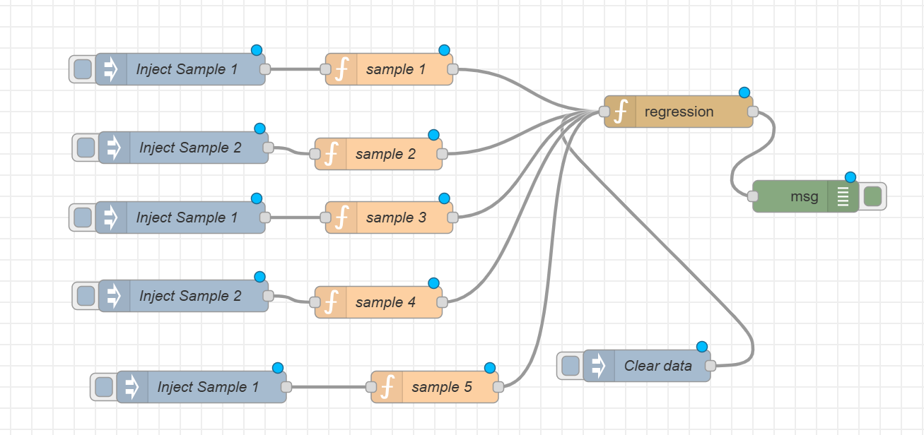
Flow

Slide 5
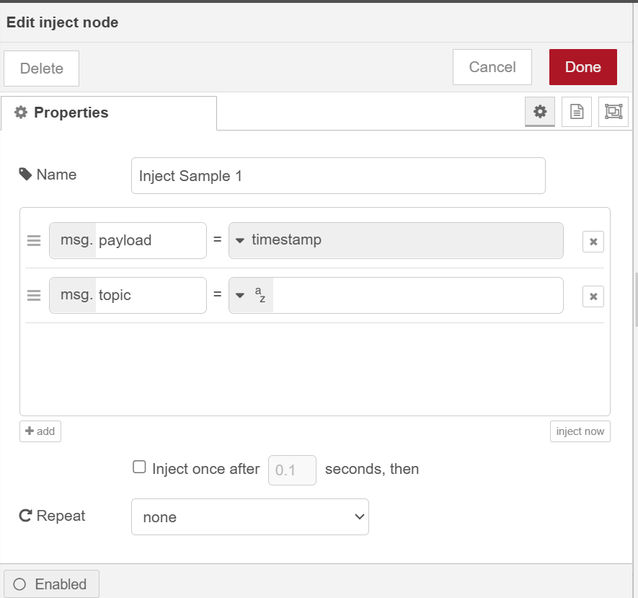
Inject Node

Slide 6
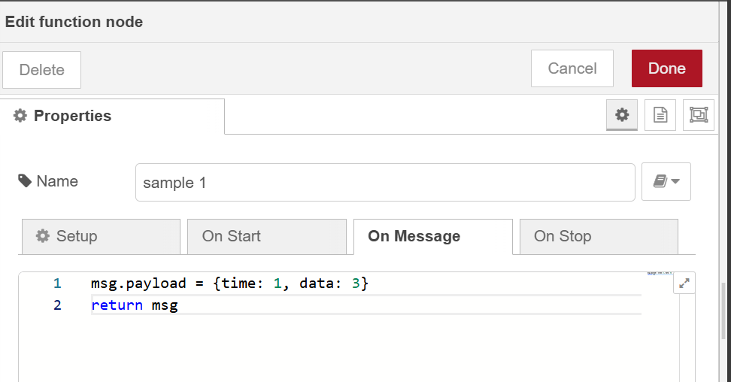
Sample function

Slide 7
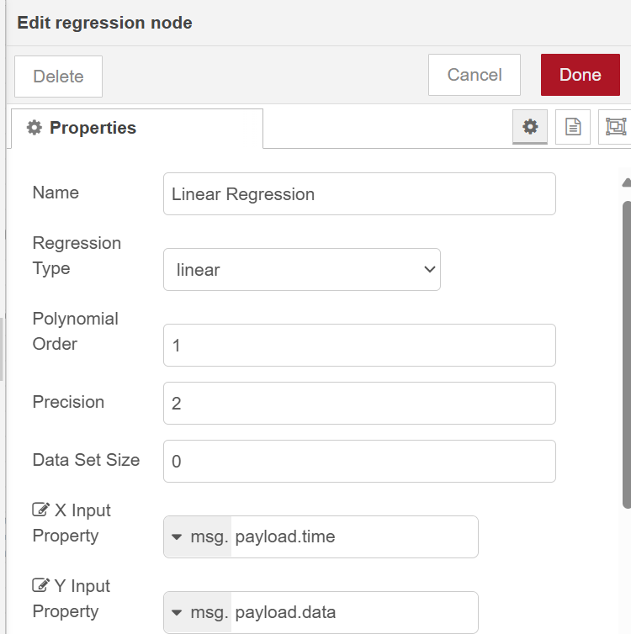
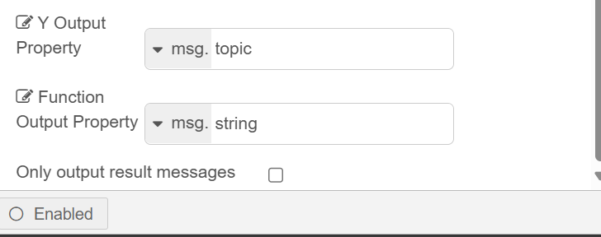
Regression Node

Slide 8
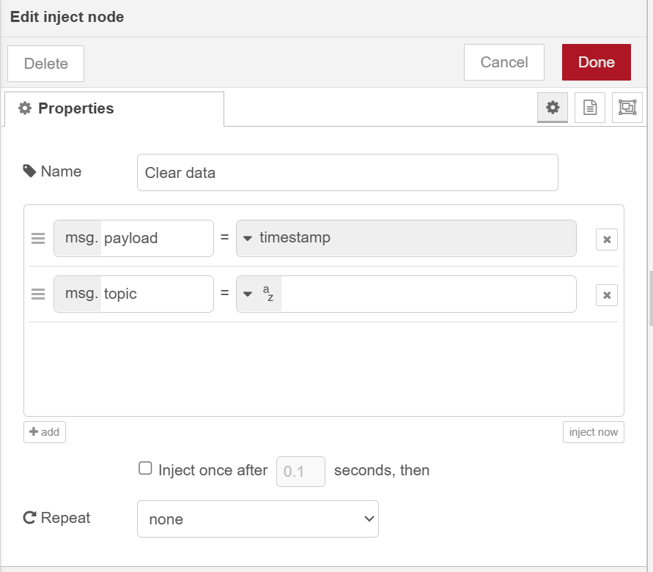
Clear Inject node

Slide 9
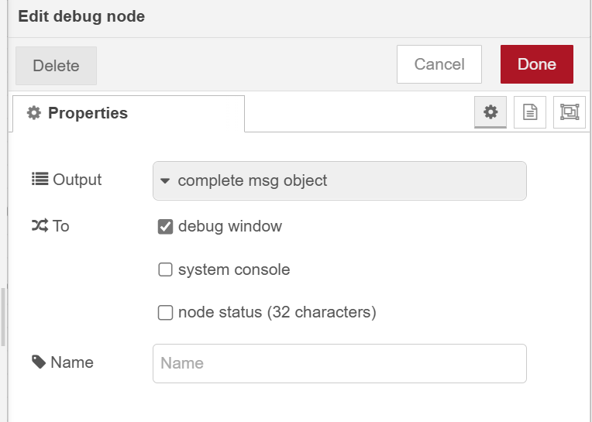
Debug Node

Slide 10
Task to Complete

